Slide 1
Iterative Methods

Slide 2
Everything covered in order of difficulty
Beginner Level
Intermediate level
Learn about iterative structures (for loop, while loop)
Perform a basic iterative computation (single and double variable)
Advanced Level
Numerically integrate a differential equation

Slide 3
Iterative Methods - Motivation
Iterative methods are what computers are REALLY GOOD AT:
Some simple calculation that needs to be repeated with small differences in input.
ODE int (from tutorial 3) is actually an iterative method! It’s just hidden inside the ODEint function so you don’t get that experience.
It’s useful for simulations of time-evolving systems, or spatially varying systems.
The principal complication is the degree to which each iteration depends on the value of the iteration before it.

Slide 4

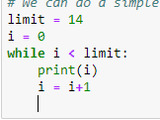
The For and While Loops
These loops allow us to repeat a computation a set number of times.
For loops allow us to do things a certain number of times
While loops allow will keep going while something is true

Slide 5
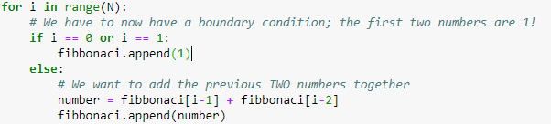
Intermediate - Iterating through time; continuous updates
Instead of simply repeating a calculation, we can iterate through time/space to make evolving calculations. Usually this involves each calculation using the data from a previous calculation.
Eg, fibbonaci sequence;
The most common way to do this is for time-evolving systems, where the current state depends slightly on the previous state.

Slide 6

Advanced starts here
We’re going to numerically simulate the following differential equation:
We’re NOT going to use ODE-int this time, because we are using this to develop our simulation skills (and we will soon hit problems for which ODEint is useless).
Strategy: 1. Determine our discretisation regime 2. Determine how to ‘step’ across our regime 3. Set up function(s) that will ‘step’ as we wish 4. Put functions in loops, iterate and solve
$$\frac{dx}{dt}=\frac{sin⁡(t)}{t}$$

Slide 7
Discretisation and Step Relationship
Hopefully you should realise that if we’re evaluating x(t) from the equation below, we need to define a range of t’s that we’re going to be using.
You need to ask;
How large a range will you be considering?
How small does the step size in t need to be?
The answer for 2 will probably come from our stepping function

Slide 8

Stepping functions
$$\frac{dx}{dt}=\frac{sin⁡(t)}{t}$$
Our goal is to turn into a formula relating our current value for x at time T, to past values for x at time t < T.
Because our simulation will be performing in discrete time steps, we want to relate the current value for x to previous values for x.
In short, we want to know; what is the relationship between x(tn) and x(tn-1), x(tn-2) etc?
If we know this, then we can always evaluate x(t=T) by using our previous values of x(t<T). This is how iterative methods are done.

Slide 9




Determining the step function
$$\frac{dx}{dt}=\frac{sin⁡(t)}{t}$$
Let’s do a first order, finite-difference approximation of the derivative:
Which we can then extend:
And we get our step-function!
$${\left(\frac{dx}{dt}\right)}_{n}=\frac{x\left(t_{n}\right)−x\left(t_{n−1}\right)}{Δt}$$
$${\left(\frac{dx}{dt}\right)}_{n}=\frac{x\left(t_{n}\right)−x\left(t_{n−1}\right)}{Δt}=\frac{\sin\left(t_{n}\right)}{t_{n}}$$
$$x\left(t_{n}\right)=x\left(t_{n−1}\right)+Δt×\frac{\sin\left(t_{n}\right)}{t_{n}}$$

Slide 10
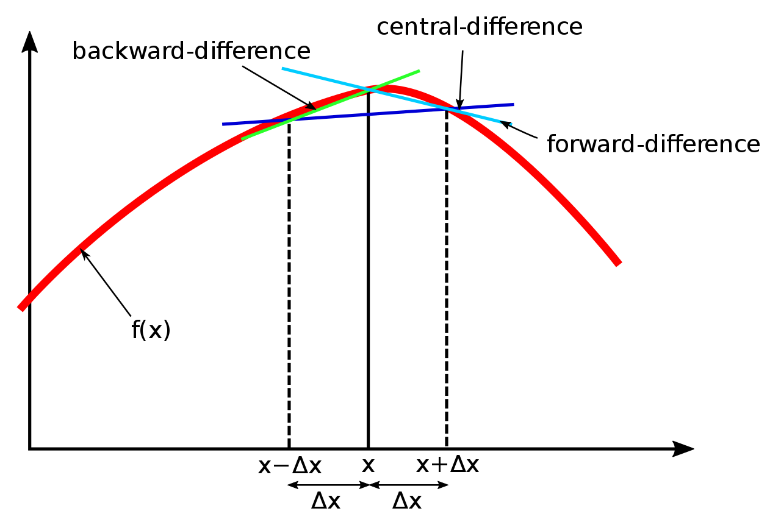
Notes on step function
Obviously this is more accurate at small timesteps (delta t)!
There are better numerical approximations of derivatives out there, I have used the simplest one.

